Slide 1
XML
And why you can’t parse it with Regular Expressions.

Slide 2
Things we’re doing.
Structure
Formatting
Specification
Validation

Slide 3
XML
Extensible Markup Language
Document specification
Rules to encode documents in machine readable format.
NOT A LANGUAGE
Goals:
Simplicity
Generality
Usability

Slide 4
XML
Broken up into entities
Tags
Elements
Attributes
Content

Slide 5
Tag
Begins with ‘<‘
Ends with ‘>’
Has things inbetween
Three flavors
Start
End
Empty-Element

Slide 6
Tags
Start Tag
Looks like <DERP>
End tag
Looks like </DERP>
Must match the start tag
Empty-Element
Looks like <DERP />

Slide 7
Attributes
Start tags and empty-elements can have attributes
Key-value pairings
Must be enclosed in quotes.
Example:
<DERP name=“sean”>
<img url=“DERP” />

Slide 8
Element
Combination of Tags and Attributes
Example:
<Document name=“testDocument”>
<param name=“author” value=“sean” />
<param name=“date” value=“10 Aug 2010” />
<data>
Some stuff here.
</data>
</Document>

Slide 9
XML Declaration.
All valid XML must have a version tag.
“<?xml version="1.0" encoding="UTF-8" ?> “
This is a specific type of tag and may only appear once, at the top of the document.

Slide 10
Example
<?xml version="1.0" encoding="UTF-8" ?>
<painting>
<img src="madonna.jpg" alt='Foligno Madonna, by Raphael'/>
<caption>This is Raphael's "Foligno" Madonna, painted in
<date>1511</date>–
<date>1512</date>.
</caption>
</painting>

Slide 11
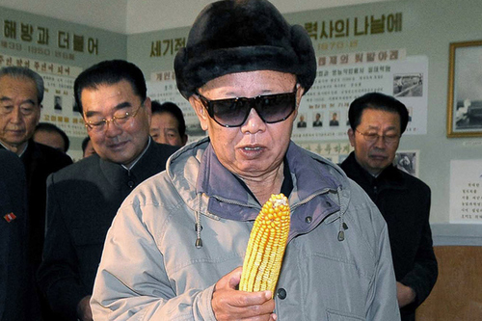
This is Kim Jong Il looking at an ear of corn.

Slide 12
Escaping text
Special tags within content:
<
&
“
Cannot use these, we use escaped versions
< = &lt;
> = &gt;
& = &amp;
“ = &quot;
‘ = &apos;

Slide 13
Unparsed Character Data
<![CDATA[
function matchwo(a,b){ if (a < b && a < 0) then { return 1; }else { return 0; } }
]]>

Slide 14
Comments
<!-- This is a comment -->

Slide 15
Document Type Definition
DTDs are used to specify a schema
Defines what attributes are in tags
Defines what tags are in tags
(Yo dawg)

Slide 16
Building Blocks:
Elements
Attributes
PCData
Cdata

Slide 17
Elements
<!ELEMENT elemname ( content) >
Elemname is the name of the element
Content is the list of elements in the element.

Slide 18
Empty element
<!ELEMENT img (EMPTY)>

Slide 19
Examples:
<!ELEMENT name (#CDATA)>
<!ELEMENT name (#PCDATA)>
<!ELEMENT name (ANY)>
<!ELEMENT note (#PCDATA)>

Slide 20
Elements with children
<!ELEMENT name (childname, …)>
<!ELEMENT note (to,from,heading,body)>
<!ELEMENT to (#CDATA)>
<!ELEMENT from (#CDATA)>
<!ELEMENT heading (#CDATA)>
<!ELEMENT body (#CDATA)>

Slide 21
Will produce the following document:
<note>
<to> sean@seanmadden.net </to>
<from>derp@me.com </from>
<heading>DERP DERP</heading>
<body>SHOOP THE WHOOP</body>
</note>

Slide 22
Occurrances
Minimum one
<!ELEMENT note (message+)>
Zero or more
<!ELEMENT note (message*)>
Zero or one
<!ELEMENT note (message?)>

Slide 23
Attributes
<!ATTLIST elemname att-name att-type def-value>
Att-type is typically CDATA
Example:
<!ATTLIST payment type CDATA “check”>
Produces:
<payment type=“check”>

Slide 24
Apache Cayenne
Apache project
Is an ORM
Object-relational Mapping
Allows reading/writing to XML as well.

Slide 25
Basic Bean

Slide 26
Encoding

Slide 27
Decoding

Slide 28
Questions.

